Slide 1
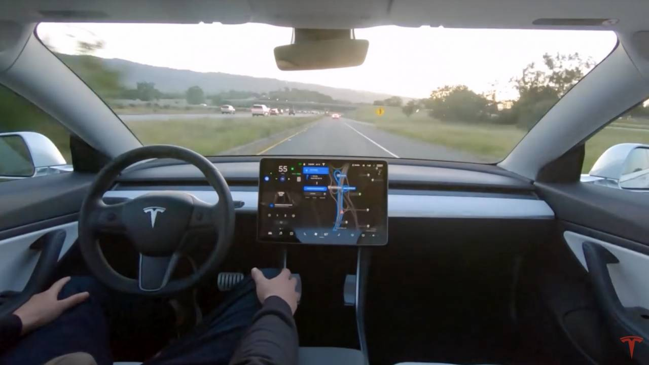
SELF DRIVING CAR LANE DETECTION SYSTEM

Slide 2


The Team
IBM Mentor
Mr. Soumya Mohanty
Edunet Mentor
Mr. Madhukar Wakhare
Student Team
Team – 72

Slide 3
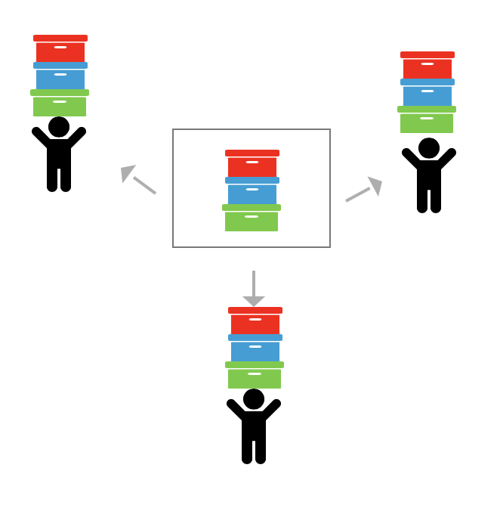
Workload Division
Contribution of each team member in project
Rana Karmakar (Team Leader)
Basudev Ghadai
Kamalesh Debnath
Damini Gurjar
Laxmi Pandey

Slide 4
The Background
Enabling fast and reliable lane lines detection and Tracking for Self driving car.
Before venturing on to any Computer Vision project it is important to pre-process the data and also to explore the data.
The dataset consists of different types of road condition like Fog and night. The Datasets are collected Internet source such as Youtube and Google.

Slide 5

Problem Statement
The problem of Road Lane Detection is to find out the Road lane automatically for self driving cars.
It is all due to the advancement in computer vision that it become possible to detect road track from video’s frames during the process of the self-driving.

Slide 6

Proposed Solution
Distortion Correction
Perspective Warp
Sobel Filtering
Histogram Peak Detection
Sliding Window Search
Curve Fitting
Overlay Detected Lane
Apply to Video

Slide 7
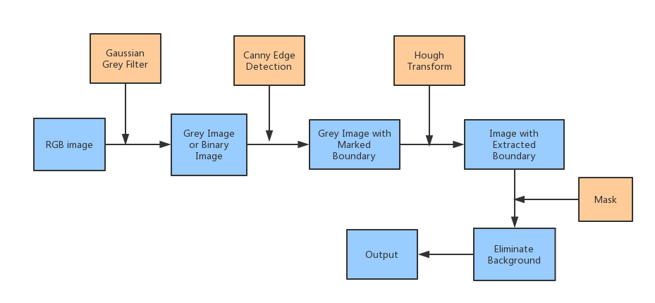
Solution Design
Work flow of the whole system given below:

Slide 8

Technology Stack & Requirements
Software Requirements
Operating System: Windows 10/8/7 (incl. 64-bit), Mac OS, Linux
Language: Python 3
Libraries: OpenCv, Numpy, Matplotlib, Pandas, OS
IDE: Jupyter Notebook/ Spyder 3
Framework: Tkinter / Streamlit
Hardware Requirements
Processor: Intel core 2 duo or higher.
RAM: 2 GB or higher
HDD: 256 GB or higher
Monitor: 1024 x 768 minimum screen resolution.
Deployed on Streamlit.io

Slide 9

Innovative Idea
Detect lanes Correctly on Indian Roads.
Work fine on Night and low light Conditions.
Light weight Application.
Easy to use.
Dashboard on the screen.
Get current Weather and Time.
High Efficient and truly Reliable.

Slide 10

Outcomes
RESULT :-
Detect lane lines in real-time
Assist Driver to Drive Safely
Solution Developed :-
Using OpenCV, Canny edge detection, and Prospective Hough Transform helps the Most.
Tested on Various road and Weather condition for Gain Efficiency and Reliability

Slide 11
Limitations
Poor Visibility Conditions like Bad Weather, Rainy Roads, Snow Covered Roads.
Bad Lighting Condition
Input Image Quality Issues
Obstacle in front of the Vehicle

Slide 12
Future Enhancements/Scope
Other Real Time Object Detection Like Car, Bikes and Human.
Batter Dashboard GUI.
Detect Lanes on Bad Weather Condition.
Road Safety

Slide 13
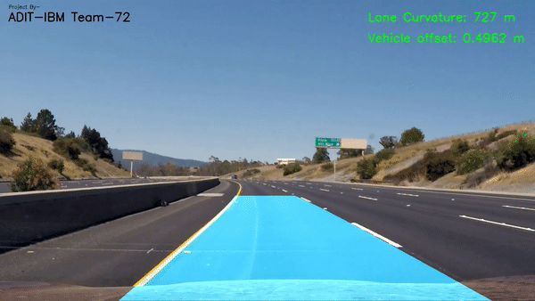
Final Output

Slide 14
Thank You

